Slide 1
Apartment Site
Dynamic Property Management App

Slide 2

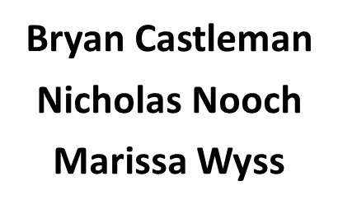
Team Isometric Interactive

Slide 3

A tool for property managers

Slide 4

A template to sell apartment communities
Maps, photos, and floor plans
Contact forms to generate prospect leads
Application forms to capture new tenant info
Keep track of leasing
Maintain parking permits and parking spaces
Contractor vendor contact list
Track and manage work orders
History of work done

Slide 5

Why?
Solve real-world problem for property managers to effectively manage their properties:
PROSPECTS: gather prospective residents for future business
APPLICANTS: process applications to approve for residency
TENANTS: manage and track tenants
CONTRACTORS: manage database of contractors, assign work
WORK ORDERS: submit, track, assign and fulfill work orders
ROI: return on investment and expense by category

Slide 6

Design
Dynamic view of property and floor plans
Login for apartment manager
Quick navigation to manager’s links
Table view of database models
View/Edit/Delete icons
Form interface for contacting and applying

Slide 7

Technologies
Node and Express Web Server
MySQL Database with a Sequelize ORM
GET and POST routes for retrieving and adding new data
Materialize
Passport
MVC folder structure
Handlebars for Server-Side Templating
Authentication

Slide 8
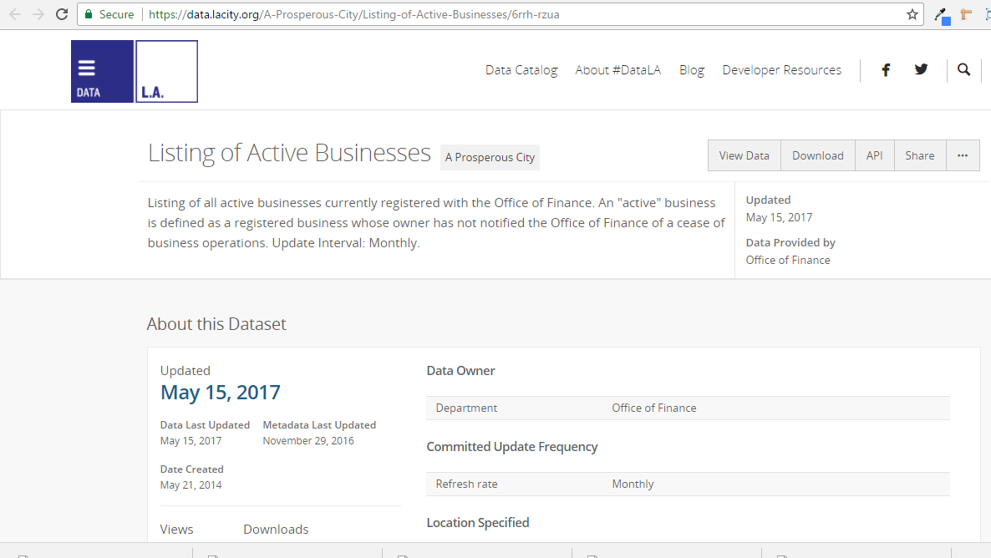
Existing Public Data Set

Slide 9
Breakdown of Tasks
Bryan Castleman: Front End UI, UX, API Calls (View)
Nicholas Nooch: Server Routes Logic (Controller)
Marissa Wyss: Sequelize/Express with Sequel (Model)

Slide 10
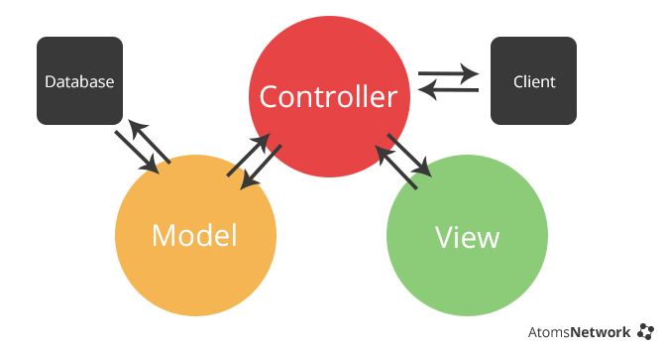
Model-View-Controller Project Structure

Slide 11
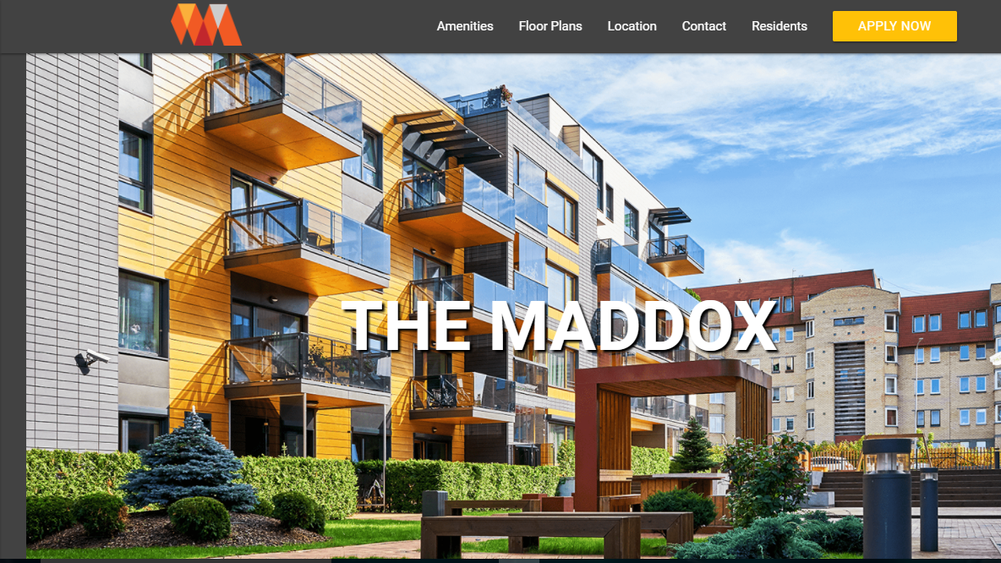
The Site

